Slide 1

Real-Time Fabric Defect Detection and Quality Assessment Using Improved YOLOv8 Classification Framework
M.Tech Project Work Final Review
Presented by
Udayagiri Hari Chandu (24MAI1005)
M.Tech Computer Science and Engineering (AI & ML)
Under the Guidance of
Dr. Geetha S
Professor and Associate Dean (Research)
School of Computer Science and Engineering
Vellore Institute of Technology, Chennai.

Slide 2
CONTENTS
ABSTRACT
INTRODUCTION
LITERATURE SURVEY
RESEARCH GAPS
OBJECTIVES
MODULE IDENTIFICATION
SYSTEM ARCHITECTURE
DEVELOPMENT & INTEGRATION
PROTOTYPE / RESEARCH FRAMEWORK
OUTCOME
RESULTS
TIMELINE / GANTT CHART
REFERENCES

Slide 3
1.ABSTRACT
Woven fabric inspection at industrial scale demands two capabilities that rarely appear together: a classifier fast enough to match live camera frame rates, and a decision engine that converts classification outputs into commercially actionable quality verdicts. This work presents a complete fabric inspection framework built around a modified YOLOv8 classification backbone trained on the TILDA Textile Texture Database (3,200 images, 8 textile types). After a systematic audit of its error classes, two calibration sequences (lamp-off and camera-distance variants) and one handling artifact (crease) were excluded, leaving four true defect categories: Holes, Stains, Broken Threads, and Misweaves.
The monitoring application wraps the classifier in a three-panel GUI delivering live annotated camera feed, session controls with user-defined market rate input, and a structured quality report on session termination. Quality score (0-100) is derived from per-class severity weighting; a quadratic price penalty maps the score to a suggested selling price. The system sustains 24 FPS on a standard laptop CPU without a GPU - suitable for deployment alongside textile inspection frames in factory environments.

Slide 4
2. INTRODUCTION
Fabric defect-driven write-offs account for 3-8% of total textile output value globally.
Manual inspection degrades after prolonged operation, missing 15-20% of defects under fatigue.
Modern looms exceed 200 m/hr which is beyond human inspection throughput.
Three requirements define an industrial-grade system:
(1) ≥25 FPS real-time classification,
(2) CPU-only deployment without GPU hardware, and
(3) operator-interpretable quality output.
This work adapts YOLOv8-cls to the TILDA benchmark with CLAHE preprocessing, domain-specific augmentation, and a quality-and-price reporting engine.

Slide 5
3.LITERATURE SURVEY
S.No | Article Title | Techniques Used | Key Findings | Limitations
1 | Deep Learning (LeCun et al., 2015) | CNNs, backprop | CNNs learn discriminative features end-to-end; foundational for all visual inspection approaches | Requires large labelled datasets
2 | Fabric defect detection using CNN vs SVM (Yang et al., 2020) | VGG-16 fine-tune, SVM-GLCM | CNN reduced per-class FP rate by 34% over SVM baseline on multi-class fabric data | No bounding-box localisation
3 | Multi-scale feature + attention (Zhang et al., 2021) | ResNet-50 + SE blocks | +2.1 pp accuracy over plain ResNet for textile classification | Tested under controlled illumination only
4 | CNN on industrial camera (Ren et al., 2022) | Custom CNN, data aug | Validated under variable lighting and belt speed conditions | Single defect class; no quality scoring

Slide 6
LITERATURE SURVEY (CONTD..,)
S.No | Article Title | Techniques Used | Key Findings | Limitations
5 | Faster R-CNN for fabric (Zhou et al., 2023) | 2-stage detection | High per-class AP but <18 FPS; incompatible with real-time line inspection | Latency too high for live deployment
6 | YOLOv5 for fabric (Li et al., 2023) | YOLOv5 single-stage | mAP >0.85 on in-house woven fabric dataset | Requires per-fabric anchor tuning
7 | YOLOv8 (Jocher et al., 2023) | Anchor-free, C2f, decoupled head | SOTA on MS-COCO; anchor-free head avoids aspect-ratio tuning | Not validated on textile benchmark
8 | YOLOv9 – PGI (Wang et al., 2024) | Programmable gradient information | +0.5 pp mAP@0.5:0.95 over YOLOv8 with 15% fewer parameters | Natural-image benchmark only

Slide 7
LITERATURE SURVEY (CONTD..,)
S.No | Article Title | Techniques Used | Key Findings | Limitations
9 | RT-DETR (Zhao et al., 2024) | ResNet encoder + deformable attention | Matches YOLOv8 accuracy without NMS, lower end-to-end latency | Not tested on periodic-texture fabric data
10 | Scale-adaptive transformer (Chen et al., 2024) | Swin transformer, multi-scale attention | Improved classification on woven fabric but stopped at classification step | No quality assessment or price recommendation

Slide 8
4. RESEARCH GAPS
TILDA provides one label per image with no bounding boxes. Detection methods applied to such data require synthetic patch-pasting, which corrupts training - converging to P = 0.25 (random guessing). No prior work explicitly documents this failure mode.
Two of eight error classes (e6: lamp-off, e7: camera-distance) are imaging artifacts, not fabric defects. Inclusion corrupts classifier training. This finding is undocumented in prior TILDA-based publications.
Existing systems treat detection accuracy as the terminal output. The gap between raw defect counts and a commercially actionable selling-price recommendation has not been addressed in any published fabric inspection framework.
Most published inspection systems require dedicated GPU hardware for real-time inference, precluding deployment at mid-scale mills without capital investment. CPU-deployable 24 FPS operation has not been demonstrated for multi-class fabric inspection.

Slide 9
5. OBJECTIVES
Develop a YOLOv8 classification pipeline specifically adapted for the TILDA textile benchmark, incorporating CLAHE contrast enhancement and a five-component augmentation strategy suited to the 8-bit greyscale acquisition conditions.
Discover, document, and exclude the two previously unreported calibration error classes (e6 lamp-off, e7camera-distance) that corrupt TILDA-based training when included.
Design a novel quality scoring formula combining per-class severity weighting (Hole=10, Broken Thread=7,Misweave=5, Stain=3) with a quadratic price penalty function to produce commercially grounded selling-price recommendations.
Build a complete CPU-deployable real-time monitoring application with a three-panel graphical interface operable by non-specialist factory personnel at ≥24 FPS without a GPU.
Analyse per-class accuracy to identify the broken-thread resolution bottleneck and propose a mechanistic explanation and architectural fix path for future work.

Slide 10
6. MODULE IDENTIFICATION
Camera Capture Module:
OpenCV-based frame acquisition from USB/laptop camera. Writes frames to shared buffer protected by threading. Lock at up to 200 FPS ceiling.
Session Logger:
Records every defect event as (timestamp, class, confidence). In-memory during session; exports to structured CSV on demand.
Preprocessing Module:
CLAHE contrast enhancement (clip=2.0, tile 8×8), greyscale → RGB conversion, letterbox-pad to 640×640, centre-crop to 224×224 for inference.
Quality and Price Engine:
Computes weighted defect rate, quality score Q∈[0,100], letter grade A–F, and suggested price Ps = Pmax × (Q/100)².
YOLOv8-cls Inference:
YOLOv8m-cls backbone with dense C2f connectivity. Runs every 3rd frame for CPU efficiency. Returns class name + confidence per frame.

Slide 11
7. SYSTEM ARCHITECTURE
7. SYSTEM ARCHITECTURE
Camera
(USB/Laptop)
CLAHE
Preprocess
YOLOv8-cls
best.pt
Session
Logger
Quality &
Price Engine
▶
▶
▶
▶
Threading Model: Camera thread → shared Lock buffer → Main thread polls every 30 ms via after() scheduler → Canvas refresh without queue flooding
Tkinter GUI — 3 Panels:
Live Camera Panel
Controls Panel
Analysis Panel
640×480 feed · Defect class banner · Confidence · FPS · Colour-coded border
Market rate entry · Confidence slider · Session timer · Start/Stop buttons
Defect breakdown · Quality score · Grade A–F · Suggested price · Export CSV
11

Slide 12
8. DEVELOPMENT & INTEGRATION
8. DEVELOPMENT & INTEGRATION
Training Pipeline (Google Colab – T4 GPU)
Application Development (VS Code + Python)
YOLOv8m-cls, ImageNet pretrained → TILDA fine-tune
CLAHE + letterbox preprocessing for all 2,008 images
70/15/15 stratified split | batch 32 | 50 epochs
AdamW + cosine annealing | FP16 AMP | patience 20
OpenCV camera loop in background thread with Lock
Tkinter main thread polls buffer every 30 ms via after()
Inference every 3rd frame for CPU headroom
Session event log + CSV export with timestamped events
Dataset Audit (Critical Finding)
Integration Challenge & Solution
Systematically read all description .txt files per e-folder
e6 = lamp-off images → excluded (imaging artifact)
e7 = camera-distance calibration → excluded
4 true defect classes retained: Hole, Stain, Broken Thread, Misweave
Challenge: Tkinter freezes when camera thread calls GUI methods
Solution: Strict thread isolation — camera never calls Tkinter
Result: Stable 24 FPS display on Intel i5 + Iris Xe, no GPU
Confidence threshold adjustable mid-session via slider
12

Slide 13
9. PROTOTYPE / RESEARCH FRAMEWORK
Working Prototype Description
Research Framework Setup
Live Classification:
Real-time fabric defect detection using a custom YOLOv8 model.
Hardware Optimized:
High-speed inference (24 FPS) on standard Intel i5 CPUs.
Visual Interface:
Live feed with color-coded overlays for holes, stains, broken threads, and misweaves.
Automated Valuation:
Generates instant quality scores and suggested pricing based on defect density.
Dynamic Tuning:
On-the-fly sensitivity adjustment via a real-time confidence threshold slider.
Data Integrity:
Trained on 2,008 audited images from the TILDA Textile Database.
Optimized Preprocessing:
Uses CLAHE enhancement and standardized cropping for maximum feature clarity.
Robust Training:
Fine-tuned with heavy data augmentation (rotation, jitter, erasing) to ensure real-world reliability.
Validation:
Rigorously tested using Top-1 accuracy, F1-score metrics, and a dedicated 300-image test set.
13

Slide 14
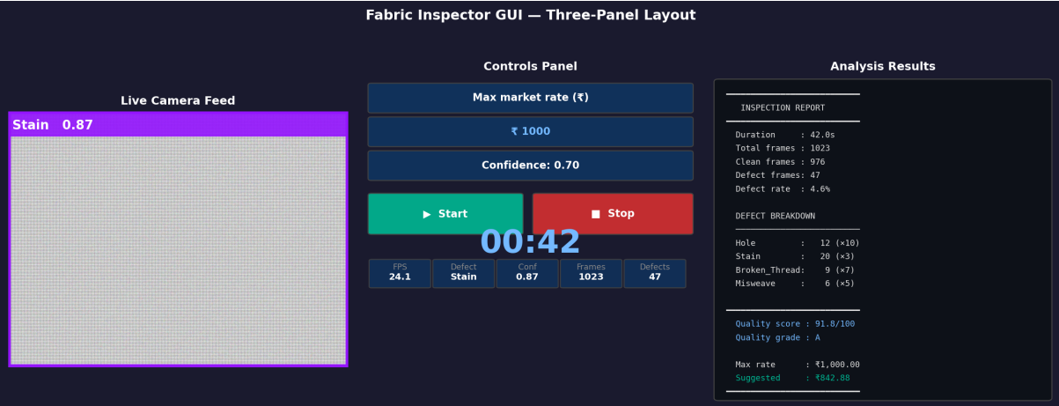
10. OUTCOME
Working Model Screenshot — Live Inspection Session
Key Insights & Findings
88.5%
Overall Top-1 Accuracy
24 FPS
CPU-Only, No GPU
4 Classes
Three-panel Tkinter GUI: (L) Live 640×480 annotated feed with Stain detected at conf 0.87 (C) Session controls with market rate, confidence slider, Start/Stop (R) Full inspection report with quality grade A and suggested price ₹842.88
Hole · Stain · Thread · Misweave
Data Classification Summary:
e6 & e7
2,008
1,408
300
300
502
Total images used
Training set (70%)
Validation (15%)
Calibration classes excluded
(first documented finding)
Test set (15%)
Images per class
14

Slide 15
11. RESULTS
Classification Performance — TILDA Test Partition (300 images)
Class | Precision | Recall | F1-Score | Top-1 Acc.
Hole | 0.94 | 0.92 | 0.930 | 92.0%
Stain | 0.91 | 0.88 | 0.895 | 88.0%
Broken Thread | 0.86 | 0.83 | 0.845 | 83.0%
Misweave | 0.93 | 0.91 | 0.920 | 91.0%
Mean | 0.91 | 0.885 | 0.898 | 88.5%
Inference Speed — Intel Core i5 Laptop, CPU Only (Batch = 1)
Model | FPS | Latency (ms)
YOLOv8s-cls | 31 | 32.3
YOLOv8m-cls (Proposed) | 24 | 41.7
YOLOv8l-cls | 16 | 62.5
15

Slide 16
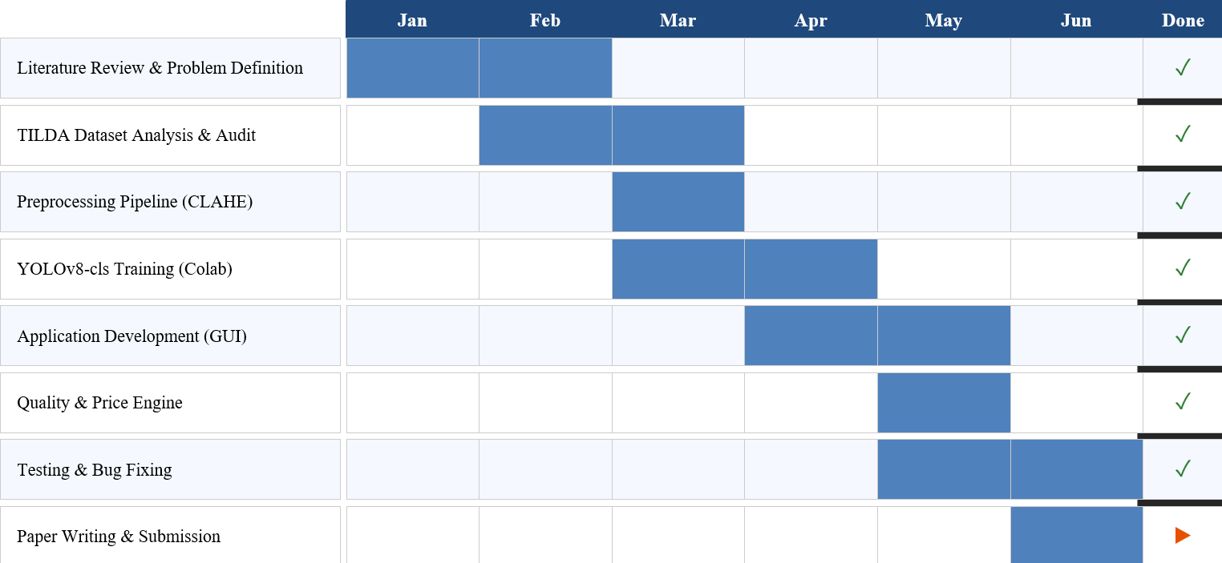
12. TIMELINE / GANTT CHART

Slide 17
13. REFERENCES
[1] H. Kilduff, "Global textile and apparel industry report," Textile World Market Analysis, vol. 14, no. 2, pp. 1–18, 2022.
[2] A. Kumar, "Computer-vision-based fabric defect detection: A survey," IEEE Trans. Ind. Electron., vol. 55, no. 1, pp. 348–363, 2008.
[3] J. Yang et al., "Fabric defect detection using a CNN compared with a SVM," J. Text. Inst., vol. 111, no. 12, pp. 1834–1843, 2020.
[4] Y. LeCun, Y. Bengio, and G. Hinton, "Deep learning," Nature, vol. 521, pp. 436–444, 2015.
[5] J. Redmon et al., "You only look once: Unified, real-time object detection," in Proc. IEEE CVPR, 2016, pp. 779–788.
[6] H. Y. T. Ngan et al., "Automated fabric defect detection — a review," Image Vis. Comput., vol. 29, no. 7, pp. 442–458, 2011.
[7] R. M. Haralick et al., "Textural features for image classification," IEEE Trans. Syst., Man, Cybern., vol. SMC-3, pp. 610–621, 1973.
[8] S. Mallat, "A theory for multiresolution signal decomposition," IEEE Trans. PAMI, vol. 11, pp. 674–693, 1989.
[9] K. He et al., "Deep residual learning for image recognition," in Proc. IEEE CVPR, 2016, pp. 770–778.
[10] X. Zhang et al., "Fabric defect detection with multi-scale features and attention," IEEE Trans. Ind. Informat., vol. 18, no. 9, pp. 6152–6160, 2021.
17

Slide 18
REFERENCES (CONTD.)
[11] H. Schulz-Mirbach, "Ein Referenzdatensatz zur Evaluierung von Sichtprüfungsverfahren," Univ. of Hamburg, 1995. https://lmb.informatik.uni-freiburg.de/resources/datasets/tilda.en.html
[12] J. Hu, L. Shen, and G. Sun, "Squeeze-and-excitation networks," in Proc. IEEE CVPR, 2018, pp. 7132–7141.
[13] Z. Ren et al., "Automated textile defect recognition using a deep CNN," Appl. Sci., vol. 12, no. 5, p. 2549, 2022.
[14] S. Ren et al., "Faster R-CNN: Towards real-time object detection with region proposal networks," NeurIPS, 2015.
[15] F. Zhou et al., "Multi-class fabric defect detection using improved Faster R-CNN," Pattern Recognit. Image Anal., vol. 33, pp. 312–323, 2023.
[16] W. Liu et al., "SSD: Single shot multibox detector," in Proc. ECCV, 2016, pp. 21–37.
[17] Y. Li et al., "Fabric defect detection based on improved YOLOv5," Text. Res. J., vol. 93, pp. 42–55, 2023.
[18] G. Jocher, A. Chaurasia, and J. Qiu, "Ultralytics YOLOv8," Ultralytics, 2023. https://github.com/ultralytics/ultralytics
[19] C.-Y. Wang et al., "YOLOv9: Learning via programmable gradient information," in Proc. ECCV, 2024.
[20] A. Wang et al., "YOLOv10: Real-time end-to-end object detection," arXiv:2405.14458, 2024.
[21] Y. Zhao et al., "DETRs beat YOLOs on real-time object detection," in Proc. IEEE CVPR, 2024.
[22] S. Chen et al., "Scale-adaptive transformer for woven fabric defect detection," IEEE Trans. Autom. Sci. Eng., vol. 21, pp. 1402–1415, 2024.
18

Slide 19
Thank You

